Slide 1
Strategic Management
Management by Robbins & Coulter, Chapter 9 (11th Edition)

Slide 2


Strategic Management
What managers do to develop the organization’s strategies.

Slide 3
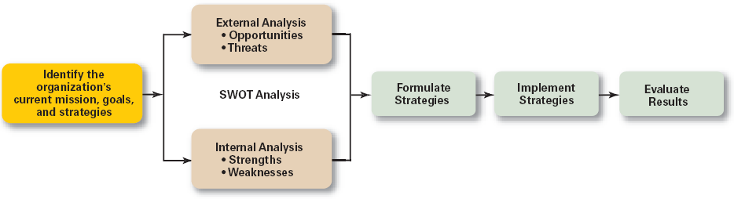
The Strategic Management Process

Slide 4
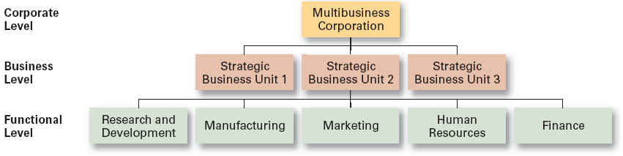
Types of Organizational Strategy
Corporate
Competitive
Functional

Slide 5
Types of Organizational Strategies
Corporate Strategies
  Top management’s overall plan for the entire organization and its strategic business units
Types of Corporate Strategies
  Growth: expansion into new products and markets
  Stability: maintenance of the status quo
  Renewal: redirection of the firm into new markets

Slide 6
Growth Strategies
Concentration
  Focusing on a primary line of business and increasing the number of products offered or markets served.
Vertical Integration
  Backward vertical integration: attempting to gain control of inputs
  Forward vertical integration: attempting to gain control of output through control of the distribution channel or provide customer service activities

Slide 7
Growth Strategies
Horizontal Integration
  Combining operations with another competitor in the same industry to increase competitive strengths and lower competition among industry rivals.
Related Diversification
  Expanding by combining with firms in different, but related industries that are “strategic fits.”
Unrelated Diversification
  Growing by combining with firms in unrelated industries where higher financial returns are possible.

Slide 8
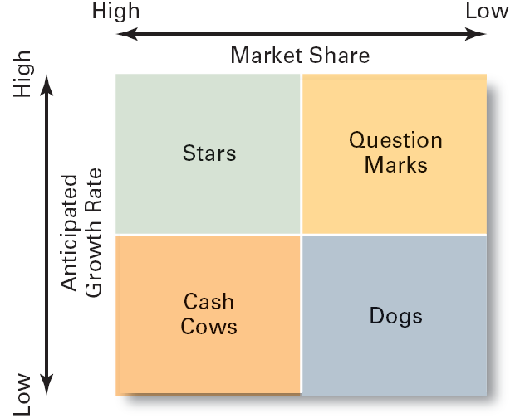
BCG Matrix
  Developed by the Boston Consulting Group
  Considers market share and industry growth rate

Slide 9

Five Competitive Forces
Threat of New Entrants
  The ease or difficulty with which new competitors can enter an industry. Cable business, online business
Threat of Substitutes
  The extent to which switching costs and brand loyalty affect the likelihood of customers adopting substitutes products and services. Cold drinks, mobile
Bargaining Power of Buyers
  The degree to which buyers have the market strength to hold power over and influence competitors in an industry. Garments industry, buyer

Slide 10


Five Competitive Forces
Bargaining Power of Suppliers
  The relative number of buyers to suppliers and threats from substitutes and new entrants affect the buyer-supplier relationship.
Current Rivalry
  Intensity among rivals increases when industry growth rates slow, demand falls, and product prices descend.

Slide 11
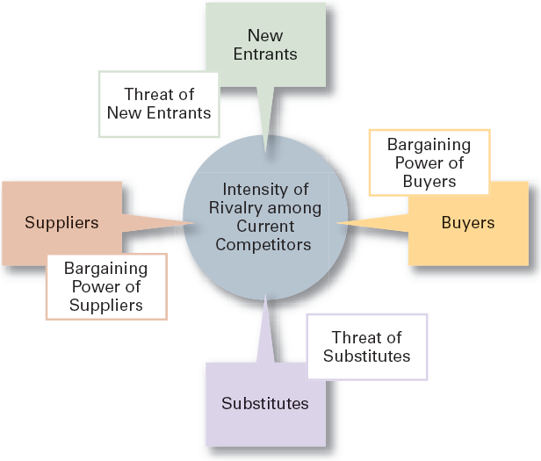
Forces in the Industry Analysis

Slide 12
Types of Competitive Strategies
Cost Leadership Strategy
  Seeking to attain the lowest total overall costs relative to other industry competitors.
Differentiation Strategy
  Attempting to create a unique and distinctive product or service for which customers will pay a premium.
Focus Strategy
  Using a cost or differentiation advantage to exploit a particular market segment rather a larger market.

Slide 13


